Slide 1
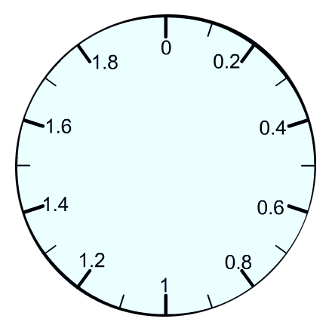
KILOGRAM
KILOGRAM
KILOGRAM
490 g
10 g
? g

